Slide 1

Week 2 (Tue): Historical Scots Myth 2: Scots is a dialect of English
/joanːa koˈpaʧɪk/
Joanna Kopaczyk
joanna.kopaczyk@glasgow.ac.uk
Drop-in hours: Tue 4pm-5pm
ENGLANG1003
English Language and Linguistics 1B: Language, Society and Change

Slide 2
Dialects and languages
Monday lectures in Weeks 7-11: Varieties of English
The intelligibility criterion:
English vs Dutch vs Spanish
Cockney vs Geordie vs Scouse
BUT
Dutch vs Flemish
Danish vs Norwegian
Czech vs Slovak
English vs Scots

Slide 3
“A language...”
“is a dialect with an army and a navy”
BUT ALSO
is a variety which has a cultural, ethnic and historical significance
which makes it different enough from surrounding - potentially intelligible - varieties
and a useful shortcut label:
cf. Old English, Middle English, Early Modern English...
... ENGLISH

Slide 4
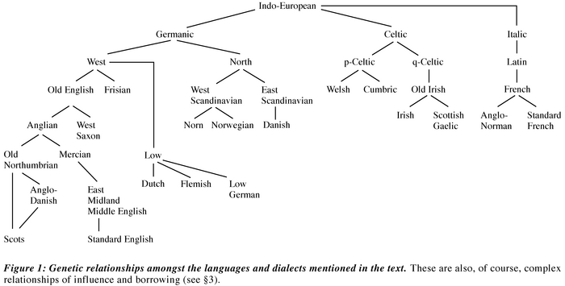
The family tree of Scots
more branches, not included here
How do English and Scots sit on a timeline?
From: Caroline Macafee and †A.J. Aitken (2002) ‘A history of Scots to 1700’ in A Dictionary of the Older Scottish Tongue vol.xii, xxix-clvii. Online: http://www.dsl.ac.uk/about-scots/history-of-scots/

Slide 5
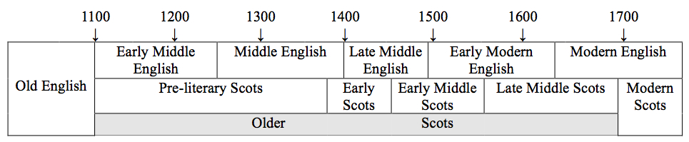
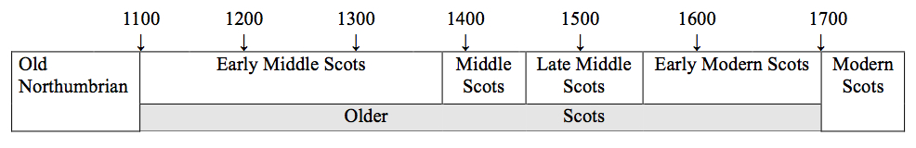
The traditional division into periods, based on the history of literature in Scots, from a mid-20th century perspective
(Aitken 1985)
A revised timeline of the history of Scots,
based on linguistic and extralinguistic criteria
(Kopaczyk 2013)

Slide 6
How different are Middle Scots (dialects) and Middle English (dialects) linguistically?
a linguistic variable
> the same feature which can have multiple realisations in different related varieties (languages / dialects)
orthographic: <sch> in the north ~ <sh> in the south
phonological: /u/ in the north ~ /au/ in the south, cf. house, toun
grammatical: speikand in the north ~ speiking in the south
lexical: burn in the north ~ stream in the south
etc.
> diagnostic variants!

Slide 7
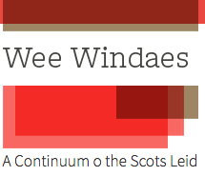
Consider this text
Richard Holland, The Buke of the Howlat
1440s (printed in 1507)
He grat gryslie grim and gaif a gret ȝoule
Hedand and chydand w(ith) churliche cheir.
“Quhy is my face”, q(uoth) ye fyle, “fassonit so foule,
My forme and my fetheren vnfrelie, but feir?
My neb is nytherit as a nok, I am bot ane Owle;
Aganis natur in ye nicht I walk in to weir;
I dare do nocht on the day, but droupe as a dovle,
Nocht for schame of my schaip in pert till appeir.”

Slide 8
Diagnostic variants: Spelling
Middle Scots | Example | Middle English | Example
<i>-digraphs for long Vs (also <y>) | deid (deyd), deil, befoir | double vowels, V+<a> | deed, deal, before
no additional marking for long Vs | ded, del, befor, gret, throt |  | throat, great
<ch> | dochtir, nocht | <gh> | daughter, naught
<quh> <qhw> etc. | quhene, qhwyte | <wh> | whene, whyte
<sch> | scho, schip | <sh> | she, ship
<y> | yat, oyir | <th> | that, other
<u> ~ <v> ~ <w> | leue, vyir, ws | <u> ~ <v> | leaue, comvne, us
+ shared variants!
e.g.
<VCe> for long vowels: time, dede, dele, gude, late

Slide 9
Diagnostic variants: Spelling
with phonological implications – different sound changes on the way from Germanic dialects to medieval Scots and English, or the effects of borrowing!
Middle Scots |  | Middle English
<ui> <u> | guid, buke | <oo> | good, book
<a> | stane, hame | <o> | stone, home
<aw> | knaw | <ow> | know
<lȝ> <nȝ> in French and Gaelic borrowings | spulȝe, batailȝe ganȝe ‘arrow’ | no such sounds | spoil, batalle
/k/ /g/ | kirk, kist, brig | /ʧ/ /ʤ/ | church, chest, bridge
<i> in unstressed syllables | matteris, haldin | <e> in unstressed syllables | matteres, holden

Slide 10
Consider this text
He grat gryslie grim and gaif a gret ȝoule
Hedand and chydand w(ith) churliche cheir.
“Quhy is my face”, q(uoth) ye fyle, “fassonit so foule,
My forme and my fetheren vnfrelie, but feir?
My neb is nytherit as a nok, I am bot ane Owle;
Aganis natur in ye nicht I walk in to weir;
I dare do nocht on the day, but droupe as a dovle,
Nocht for schame of my schaip in pert till appeir.”
spelling

Slide 11
Diagnostic variants: Grammar
 | MSc | Example | ME | Example
pronouns
indicative | thir – tha – yon |  | these - those
3sg feminine | scho |  | she
inflection
possessive | -is/-ys | kingis quair | -es | kinges booke
plural nouns | -is/-ys | kirkis, tounis | -es | churches, townes
present tense | -is/-ys | cummis, leiffis | -eth | cometh, leaveth
present participle | -and | luikkand, lefand | -ing | looking, living
past tense | -it/-yt | lukkit, presentit | -ed | looked, presented
past participle | -it/-yt -in/-yn | ordanit and haldyn | -ed -en | ordained and holden (held)
syntax
negation | He na sal lyff. Scho consentis nocht. |  | He shal leve not.
Notes:
do/does for negation had not developed yet!

Slide 12
Consider this text
He grat gryslie grim and gaif a gret ȝoule
Hedand and chydand w(ith) churliche cheir.
“Quhy is my face”, q(uoth) ye fyle, “fassonit so foule,
My forme and my fetheren vnfrelie, but feir?
My neb is nytherit as a nok, I am bot ane Owle;
Aganis natur in ye nicht I walk in to weir;
I dare do nocht on the day, but droupe as a dovle,
Nocht for schame of my schaip in pert till appeir.”
spelling
grammar

Slide 13
Diagnostic variants: Lexis
 | MSc | Example | ME | Example
derivation
deverbal noun | -ar(e) | makar, baxtar | -er | maker, baxter ‘baker’
adjectives | -abill | delitabill | -able | delightable
Middle Scots - lexis shared with Northern Middle English
from Old Northumbrian roots, e.g. wee, burn, bairn, neb, tae bide
Old Norse borrowings, e.g. gar ‘to cause’, till big ‘to build’
Middle Scots - unique borrowings
unique French borrowings, e.g. chemis ‘principle house’ OFr chef més
unique Latin borrowings, e.g. depone ‘testify’, cedent ‘the person who yields property’
unique Dutch/Flemish borrowings, e.g. calland ‘a customer > a young man’
unique Gaelic borrowings, e.g. cairn ‘a heap of stones’, capercailȝe ‘the wood grouse’

Slide 14
Consider this text
He grat gryslie grim and gaif a gret ȝoule
Hedand and chydand w(ith) churliche cheir.
“Quhy is my face”, q(uoth) ye fyle, “fassonit so foule,
My forme and my fetheren vnfrelie, but feir?
My neb is nytherit as a nok, I am bot ane Owle;
Aganis natur in ye nicht I walk in to weir;
I dare do nocht on the day, but droupe as a dovle,
Nocht for schame of my schaip in pert till appeir.”
spelling
grammar
lexis

Slide 15
Let’s look at some contemporary texts and see how they differ
National histories
John Bellenden’s translation of Hector Boece’s Scotorum historiae (printed in Edinburgh in 1540)
Author unknown, Cronycles of the londe of Englond (printed in Antwerp in 1493)
[both available through Early English Books Online, access: Glasgow University Library]

Slide 16
Author: Hector Boece (1465?-1536)
Original title: Scotorum historiae
Translated by: John Bellenden
Title: Heir beginnis the hystory and croniklis of Scotland
From: Early English Books Online (EEBO) through Glasgow University Library electronic resources
Printed by Thomas Dauidson
in 1540? in Edinburgh

Slide 17
The contentis of this buke.
IN the first the proheme apon the cosmographie schawand ye fyne of vicius and virtewis leiffing. And causis quhy the translatoure tuke this werk on hand.
¶The discriptioun of Scotland deuidit in rubrikis & cheptouris.
¶Ane compendious narratioun of the auld institutionis, maneris & leuing of scottis with ane morall doctryne deploring sindry recent and euill conswe[=]tudis brocht in this realme, to the gret difformite of the pepill now present in the samyn.
¶Ane schort recapitulation of all kyngis of Britane fra the first beginning thairof, to the empire of kyng Hary the .viii. regnand now with gret felicite aboue Inglismen.
¶The table of ye historie contenand euery buke & cheptour, craftely seuerit be thaym self.
¶The names of all kyngis and gouernouris of Scotland sen the realme began. Schawing in quhat bukis and cheptouris of the historie followyng thair lyuis and marciall dedis salbe esalie foundin.
¶The proheme apon the historie schawand breiffelie the contentis & maist notable thingis in this buke.
¶The beginnyng of Scottis & quhy thay wer callit with that name, thair happy cumyng out of Egipt to Spanye, Ireland, the Ilis of Albion, and to that regioun that wes callit be thaym Scotland.

Slide 18
Author: Unknown
Title: Cronycles of the londe of Englond
Printer: Gerard de Leew
Publication date: 1493
Place of publication: Antwerp
Available from: Early English Books Online (EEBO) through Glasgow University Library electronic resources (abbreviations expanded in italics)

Slide 19
Here begynneth the table of thys
boke / that men kalled Cronycles
of the londe of Englond
FIrst in the prologue is con
teyned. how Albyne wyt
hir sustres entrid into this
Ile. & named it Albyon
¶The begynnyng of the book con
teyneth how brute was engendred
of them of Troye. & how he slew
his fadre & modre Cap. j
How Brute was dryuen oute of
his lande: & how he helde hym in
grece / and delyuered the Troyans
there out of bondage
Ca. ij
How Coryn becam brutes man
& how kyng Goffar was disconfited
& of the foundacyon of Tours in
Torayne capit. iij /
How brute arryued atte Totte-
nesse in the Ile of Albyon. & of the
bataill bitwenn Coryn & Gogma
gog / capitu. iiij
How Brute made London: & na-
med this londe britaigne. & scotland
albanye: & Walys Cambre. & of
the deuysion of the londe to his thre
sones Capit. v.
How kyng Madan regned in
pees. & of the deth of his sones / &
how that one slow that othir / and
how after the wulfes slewe hym
that had slayne his brother. ca. vj

Slide 20
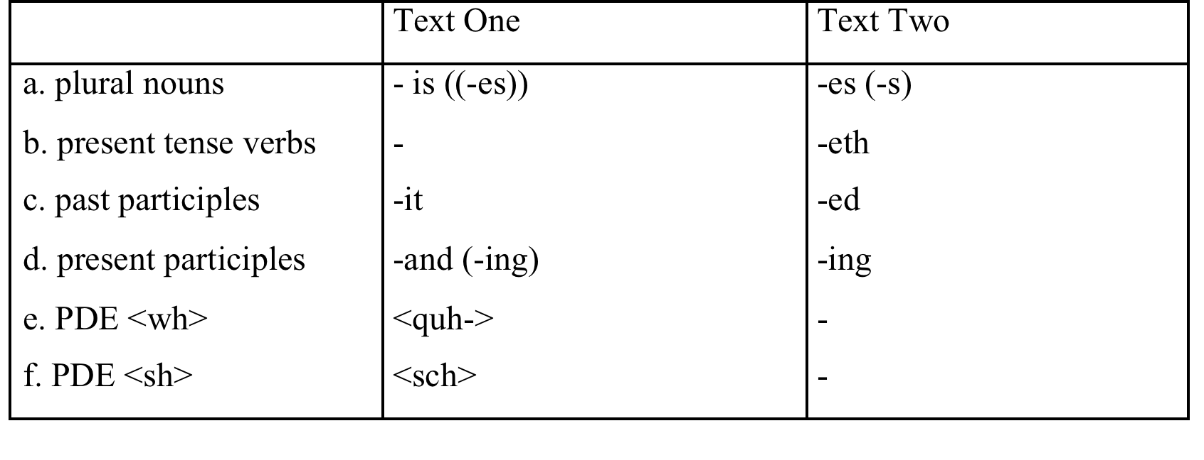
This is how they differ in terms of selected diagnostic variants
Middle Scots!
Middle English!

Slide 21

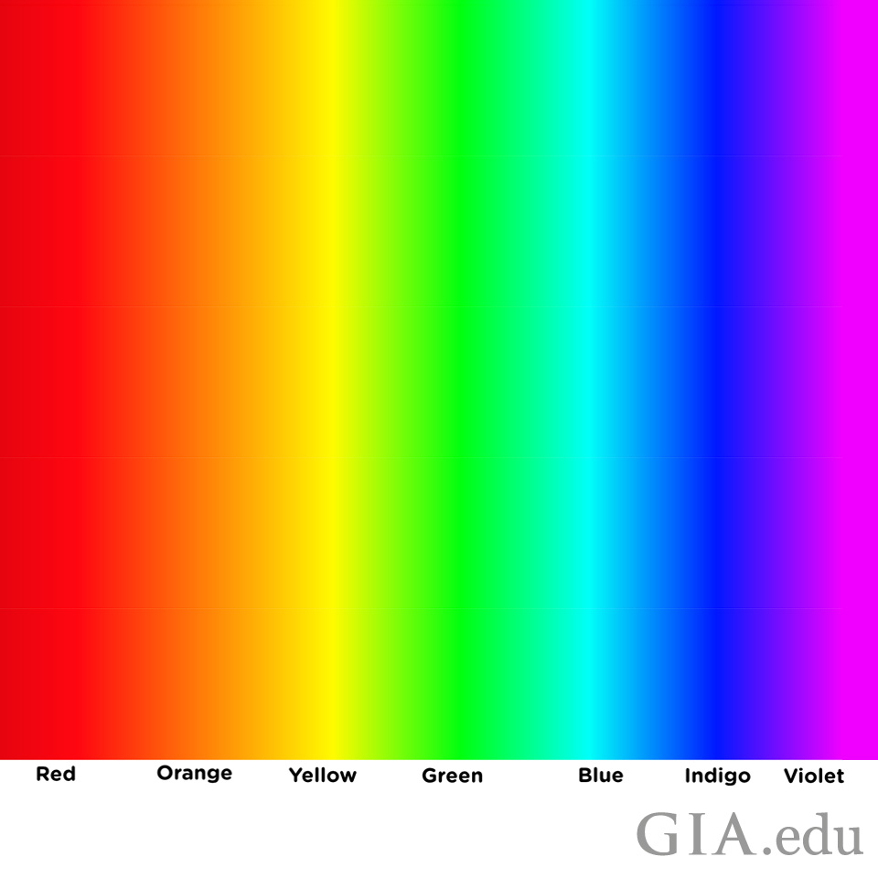
Middle
Scots
Middle
English

Slide 22
Take-away points
Middle Scots and Middle English are found at different points of a dialect continuum...
But they are different enough linguistically
> we can assign an unknown text to either on the basis of diagnostic variants (in the majority of cases)
So they both merit a label of a separate language.

Slide 23
Modern Scots
(Standard)
English

Slide 24
Take-away points
4. Scots is NOCHT a dialect of English because:
Scots dialects and English dialects developed in parallel in different locations, from different – albeit related – Germanic dialects;
They became recognised as separate entities in their respective geographic, cultural, ethnic, social and political environments.

Slide 25
Take-away points
CORRECTION:
Scots is a Germanic (collection of dialects / cultural, and ethnic phenomenon) > language developed in the North, closely related to English
JUST LIKE
English is a Germanic (collection of dialects / cultural and ethnic phenomenon) > language developed in the South, closely related to Scots

